Slide 1
Provision A Data Warehouses
06 Mar, 2025

Slide 2
Course : Amazon Redshift
Lecture On : Provision A Data Warehouse
Instructor : Nitin

Slide 3
In Last Class, we covered….
01
Overview and best practices for Stored Procedures
02
Creating and managing S3 buckets
03
Data uploading, versioning, lifecycle management
04
Security and access management
05
Integration

Slide 4
Poll 1
How familiar are you with AWS Redshift
Very familiar, I use it regularly.
Somewhat familiar, I've used it a few times.
Not very familiar, I've heard of it but haven’t used it.
Completely unfamiliar with AWS Redshift.

Slide 5
Today’s Agenda
01
Why Amazon Redshift for data warehousing?
02
Overview of Amazon Redshift
03
Amazon Redshift architecture
04
Amazon Redshift features

Slide 6
Why Amazon Redshift ?
Amazon Redshift is a popular choice for data warehousing due to several key features that make it well-suited for handling large-scale data analytics.
Here are some reasons why Amazon Redshift is commonly used for data warehousing:
Scalability
Performance
Cost-Effective
Integration with AWS Ecosystem
Security
Fully Managed
Easy Migration and Query Performance Tuning
Real-Time Data Analytics

Slide 7
Overview of Amazon Redshift
Amazon Redshift is a fully managed, petabyte-scale cloud data warehouse service in the Amazon Web Services (AWS) ecosystem.
It is designed to handle large-scale data analytics and provide fast query performance, making it a popular choice for businesses looking to store and analyze vast amounts of data in the cloud.
Here are the key components
Massively Parallel Processing (MPP)
Columnar Storage
Redshift Clusters

Slide 8
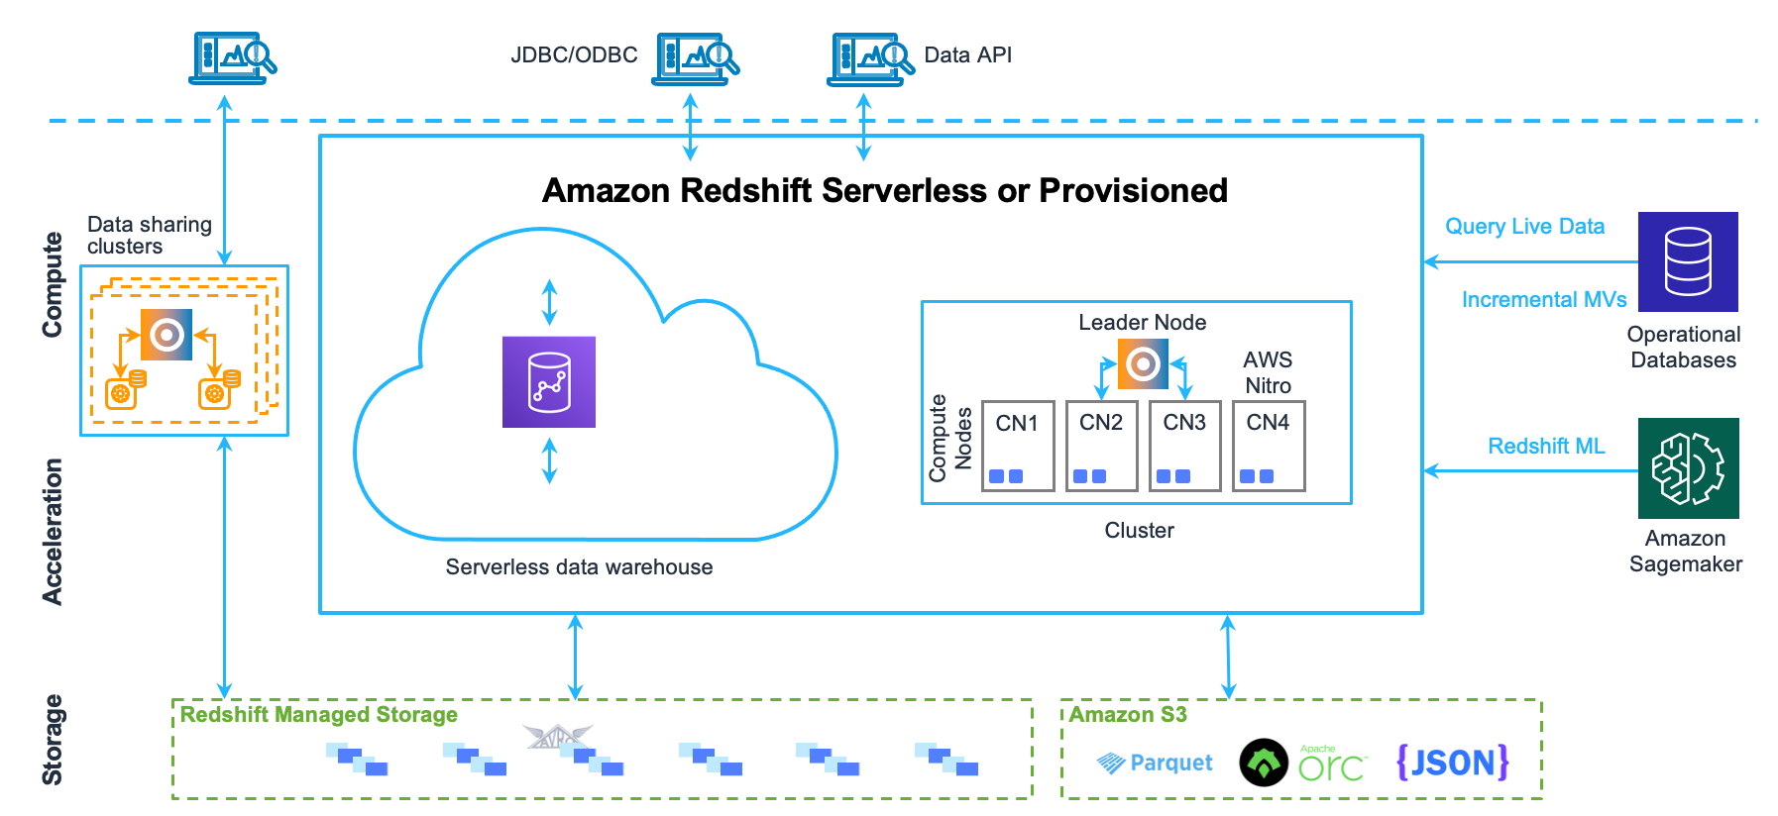
Amazon Redshift Architecture

Slide 9
Overview of Amazon Redshift
Cluster
The core infrastructure component of an Amazon Redshift data warehouse is a cluster.
A cluster is composed of one or more compute nodes.
If a cluster is provisioned with two or more compute nodes, an additional leader node coordinates the compute nodes and handles external communication.
Your client application interacts directly only with the leader node.

Slide 10
Overview of Amazon Redshift
Leader Node
The leader node manages communications with client programs and all communication with compute nodes.
It parses and develops execution plans to carry out database operations, in particular, the series of steps necessary to obtain results for complex queries.
Based on the execution plan, the leader node compiles code, distributes the compiled code to the compute nodes, and assigns a portion of the data to each compute node.

Slide 11
Overview of Amazon Redshift
Compute Node
The leader node compiles code for individual elements of the execution plan and assigns the code to individual compute nodes.
The compute nodes run the compiled code and send intermediate results back to the leader node for final aggregation.
Each compute node has its own dedicated CPU and memory, which are determined by the node type.
As your workload grows, you can increase the compute capacity of a cluster by increasing the number of nodes, upgrading the node type, or both.

Slide 12
Cost Effective
Scalability
Machine Learning Integration
Columnar Storage
Redshift Features
SQL-Based Queries
Massively Parallel Processing
Integration with AWS Ecosystem
Performance Optimization

Slide 13
Knowledge Check
Which Amazon Redshift component manages data distribution across compute nodes?
Leader Node
Compute Node
Spectrum
Redshift Spectrum

Slide 14
Knowledge Check
Which Amazon Redshift component manages data distribution across compute nodes?
Leader Node
Compute Node
Spectrum
Redshift Spectrum

Slide 15
Knowledge Check
Which type of Amazon Redshift node can automatically scale its compute capacity while maintaining performance consistency?
Dense Compute (DC2)
Dense Storage (DS2)
RA3 Node
DC1 Node

Slide 16
Knowledge Check
Which type of Amazon Redshift node can automatically scale its compute capacity while maintaining performance consistency?
Dense Compute (DC2)
Dense Storage (DS2)
RA3 Node
DC1 Node

Slide 17
Knowledge Check
Which of the following storage options does Amazon Redshift use for storing large datasets?
Elastic Block Store (EBS)
Amazon S3
Local storage on compute nodes
Elastic File System (EFS)

Slide 18
Knowledge Check
Which of the following storage options does Amazon Redshift use for storing large datasets?
Elastic Block Store (EBS)
Amazon S3
Local storage on compute nodes
Elastic File System (EFS)

Slide 19
Demo
Creating Amazon Redshift cluster

Slide 20
KEY TAKEAWAY
01
What is Data warehouse and features of Amazon Redshift
02
Provisioning A data warehouse using AWS console

Slide 21
NEXT CLASS
01
Overview of DBeaver
02
Connecting to Redshift Cluster using DBeaver
03
Securing the Amazon Redshift cluster connection
04
Monitoring and troubleshooting

